Slide 1
Hydrogen Fuel Cells

Slide 2
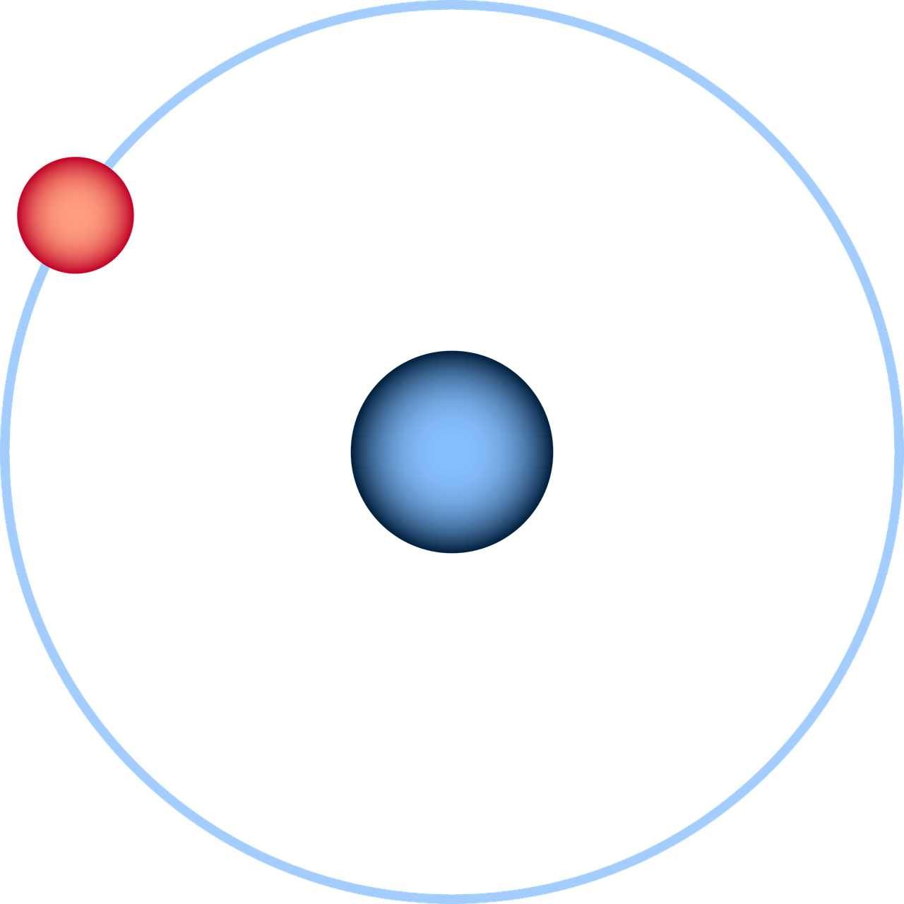
Table of Content:
How fuel cells work
Historic milestones
Use cases
Current situation and issues
Future developments

Slide 3

Vocabulary
Combustion: Verbrennung
Fuel Cell: Brennstoffzelle
Hydrogen: Wasserstoff
Oxygen: Sauerstoff
Abbrievations:
BEV: battery electric vehicle
ICE: internal combustion engine

Slide 4
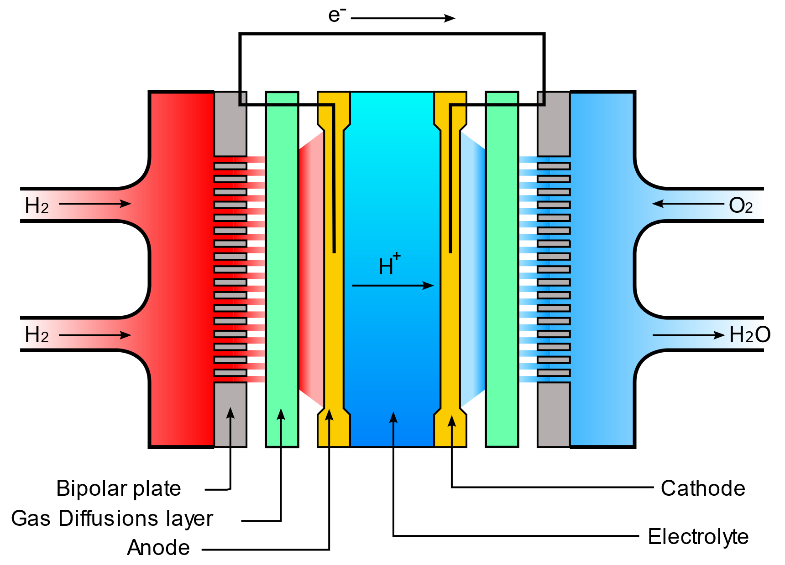
How fuel cells work
Chemical reaction of hydrogen and oxygen.
Membrane only allows Protons to pass.
Electrons are rerouted, a current is produced.
„Waste“ products are Heat and Water.
© Matthias M., Adrien Pilleboue @ Wikipedia, FAL Copyleft licence. Translated by Patrick Frings
Notes:
GDL splits H2 to H
{\mathrm {2\ H_{2}+O_{2}\to 2\ H_{2}O}}
H+ passes through PEM
H- takes scenic route, current is produced.
Air has to be cleaned via catalyst (like ICE exhausts)

Slide 5
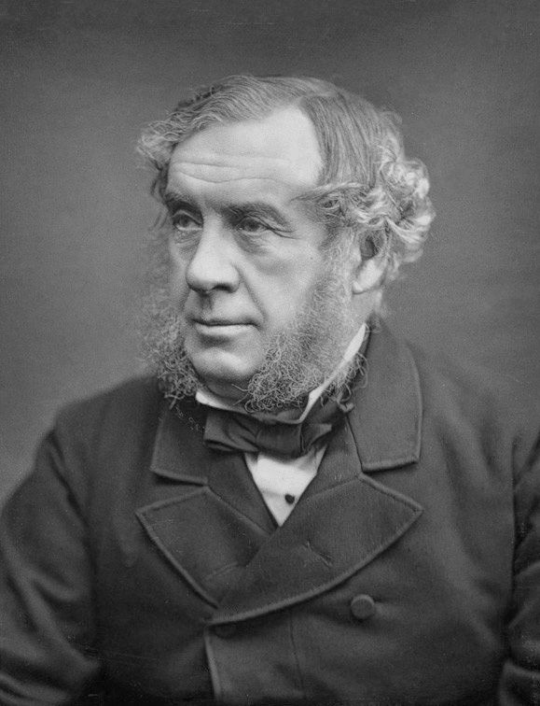
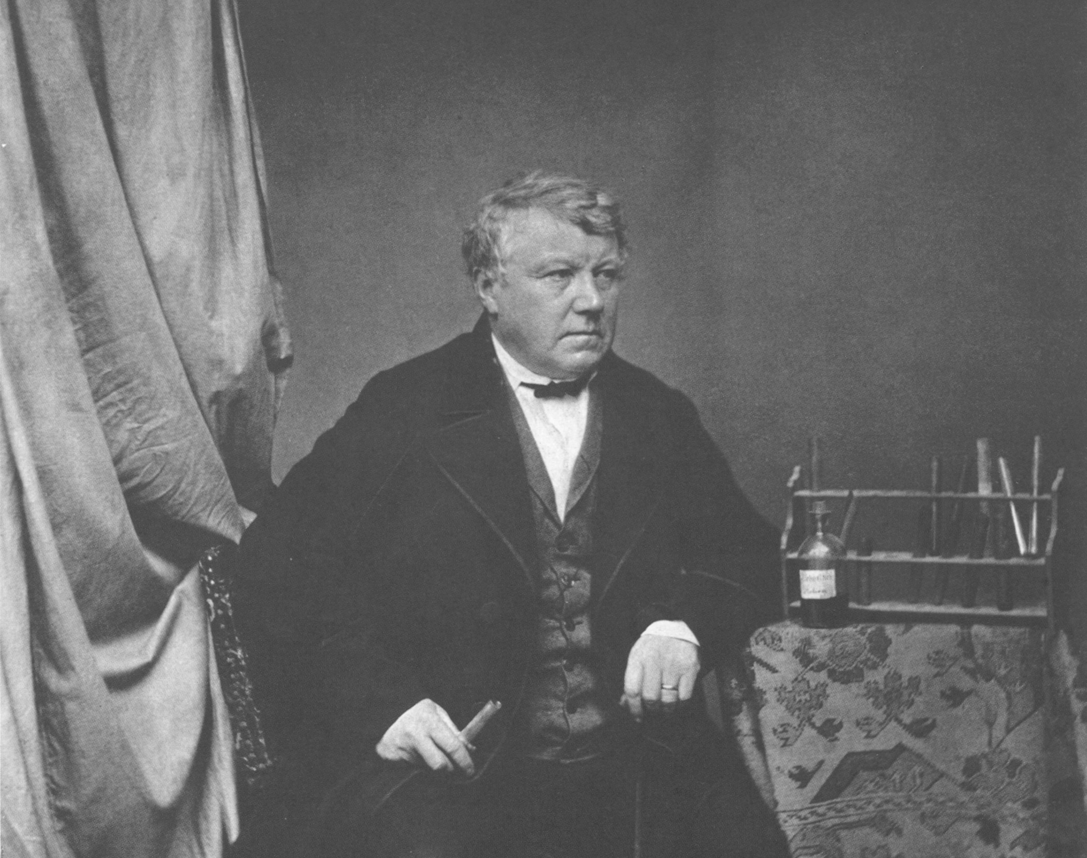
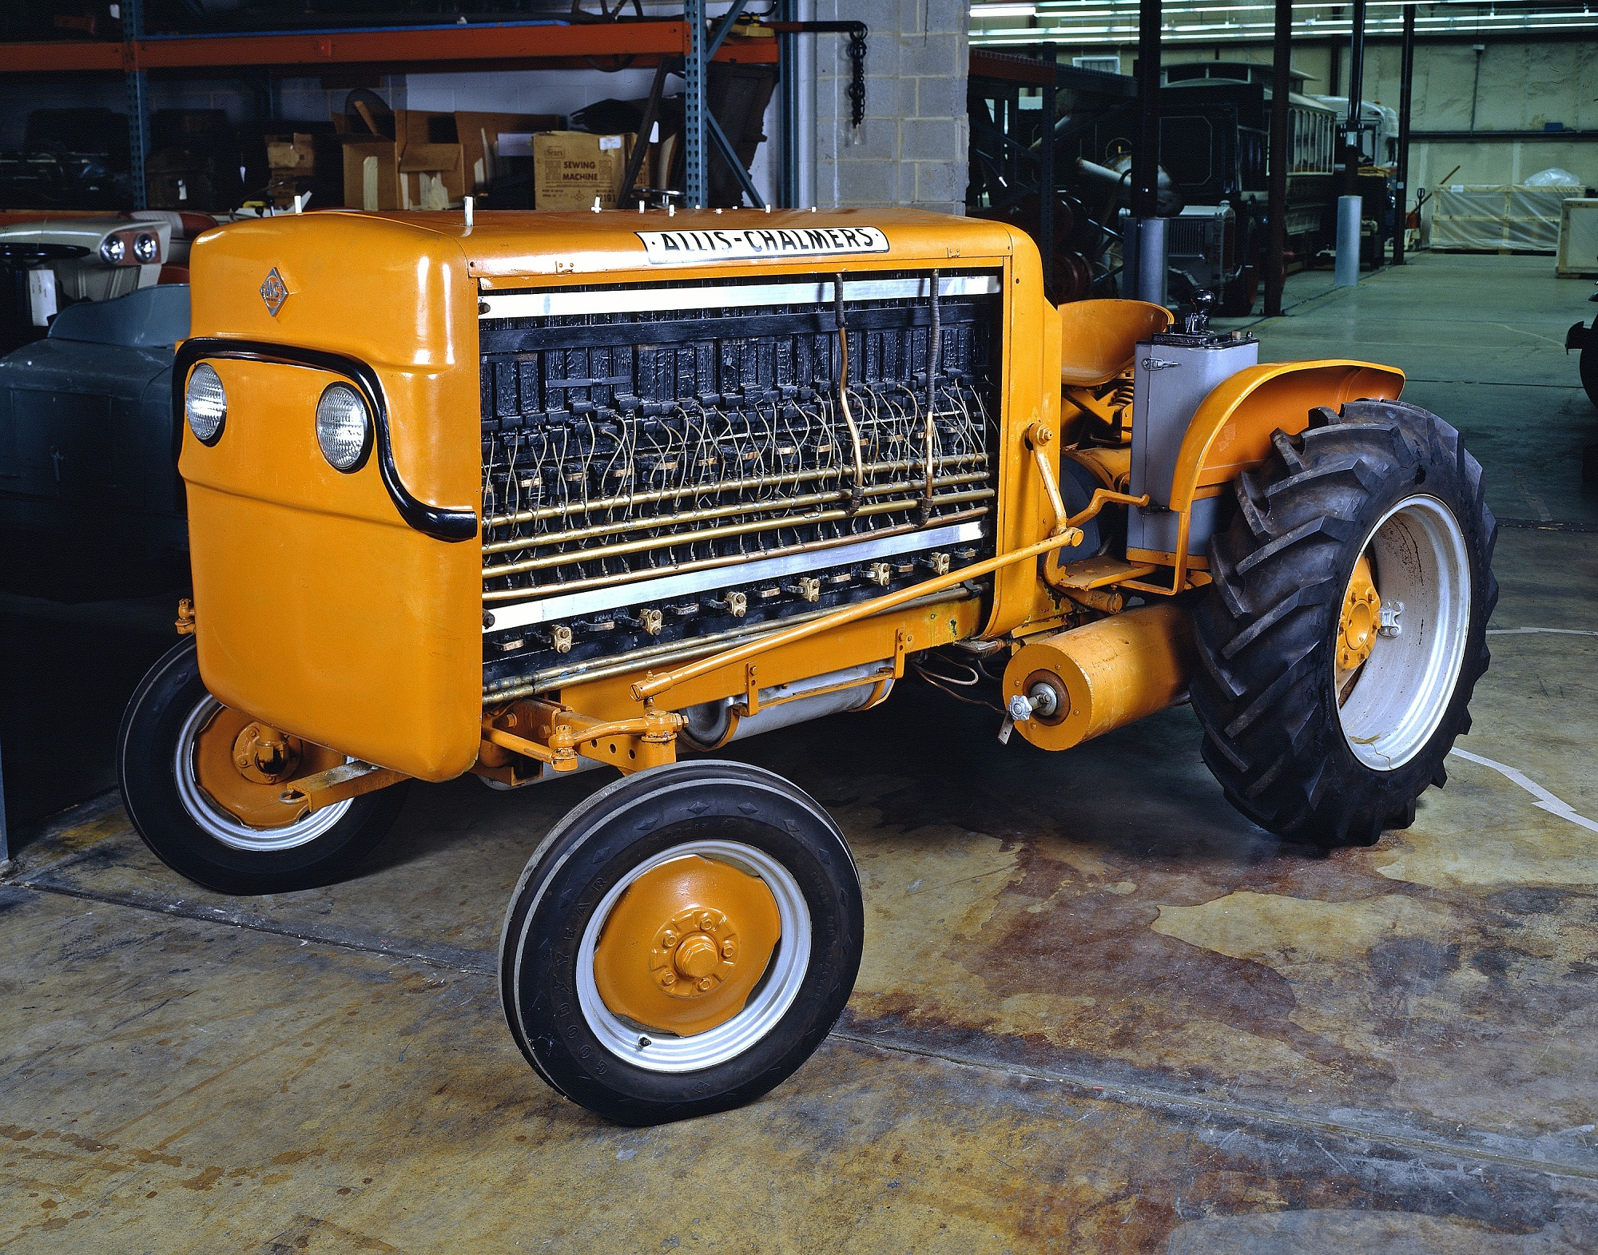


Historic milestones
1838: Christian F. Schönbein discovers hydrogen electrolysis
1839: William R. Grove develops first „gas battery“
1959: first fuel cell tractor
1960s: Apollo & Gemeni programs
Notes:
1866: Werner von Siemens, dynamo electric machine
Spaceflight usage: onboard electricity, drinking water supply
Allis-Chalmers fuel cell tractor: 1008 cells, 750V combined, 15 kW
Too expensive, but led to different contracts with NASA and USMil.

Slide 6
Use Cases
Automotive
Off-Grid generators
Seafaring
Aviation
Heating
Notes:
Automotive: obv. use case. Asian companies push tech hard
OGG: Hyundai Generator for ETCR presented @ IAA 2019
Seafaring: Pilot project in BE filling station and NL h2 inland ship
German Center for Aviation and Spaceflight (DLR): First flight of 4 seated fuelcell-battery-plane; 80kW, 165kph cruisespeed, range 750-1500 (dep.)
Heating: second product of the chemical reaction. Combined local efficiency of 95%, electricity sold to the grid just like solar energy

Slide 7


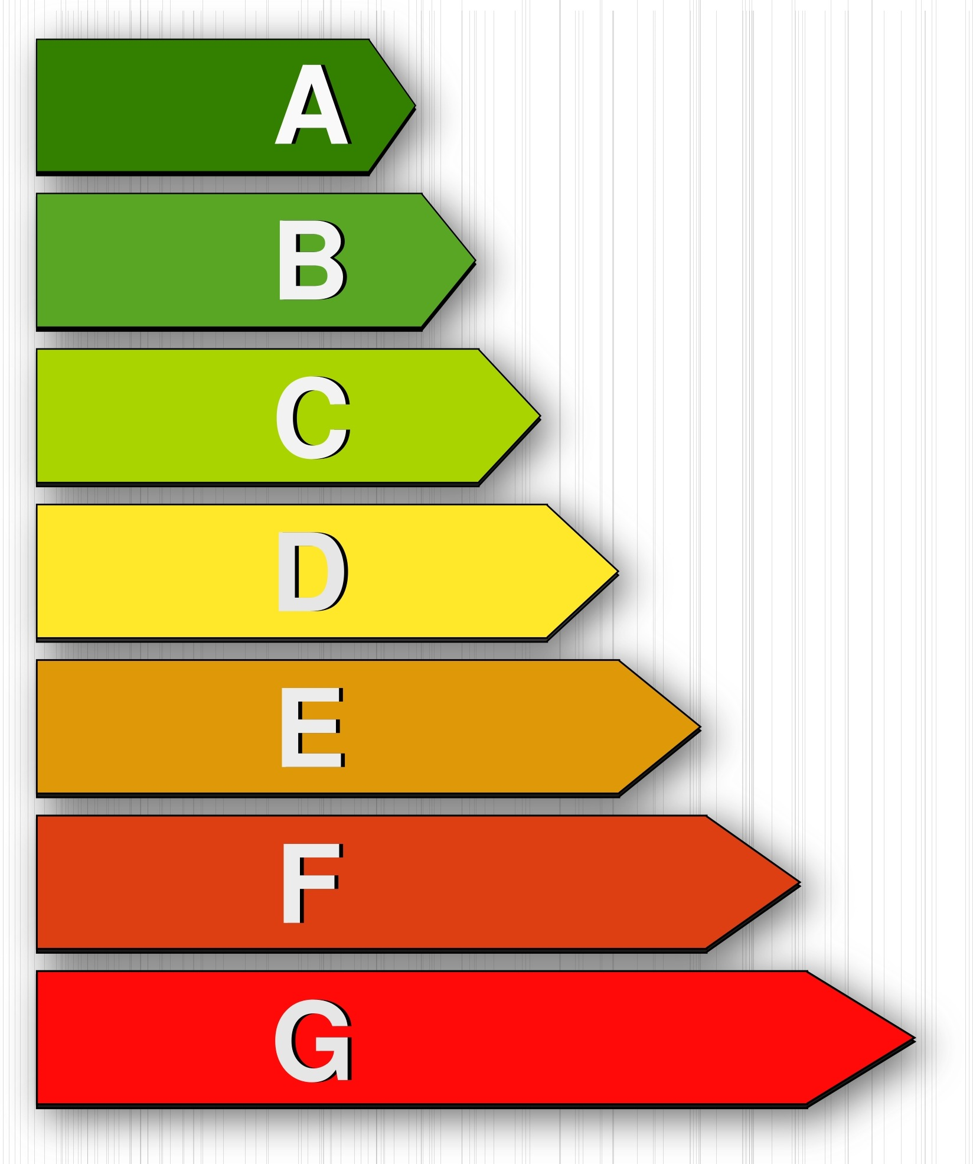

Current situation and issues
Expensive components
Poorly developed filling station network
System efficiency behind BEV, but better than ICE.
Production of Hydrogen mostly not CO2 netural
Notes:
Eg. Catalyst 60g platinum, ICE catalyst 20g
76 filling stations in DE, 45 everywhere else combined
H2:
No natural sources
Steam reforming (Natural gas)
Electrolysis (Power-to-Gas)

Slide 8
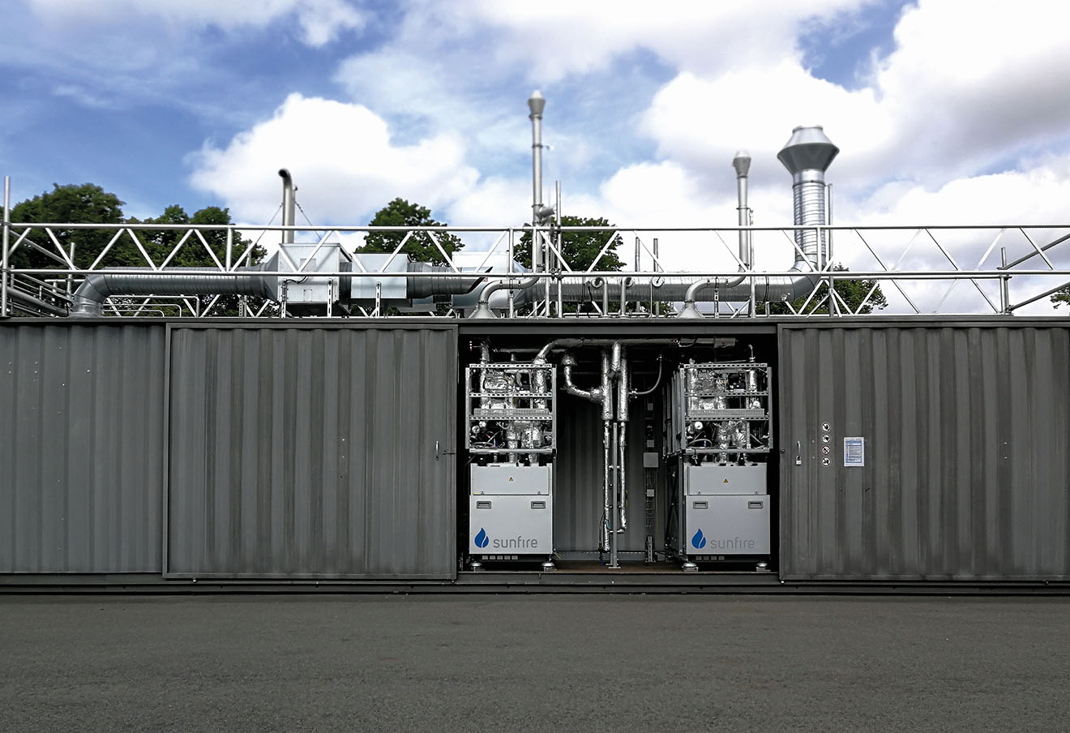
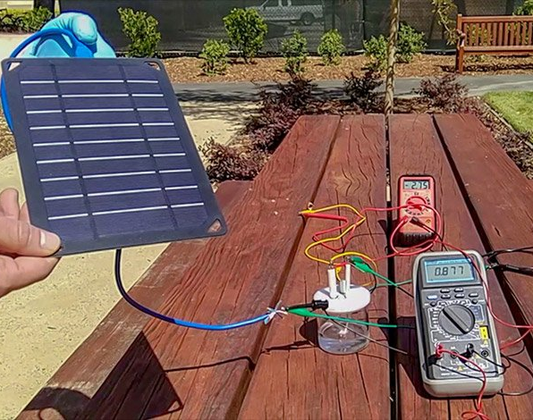
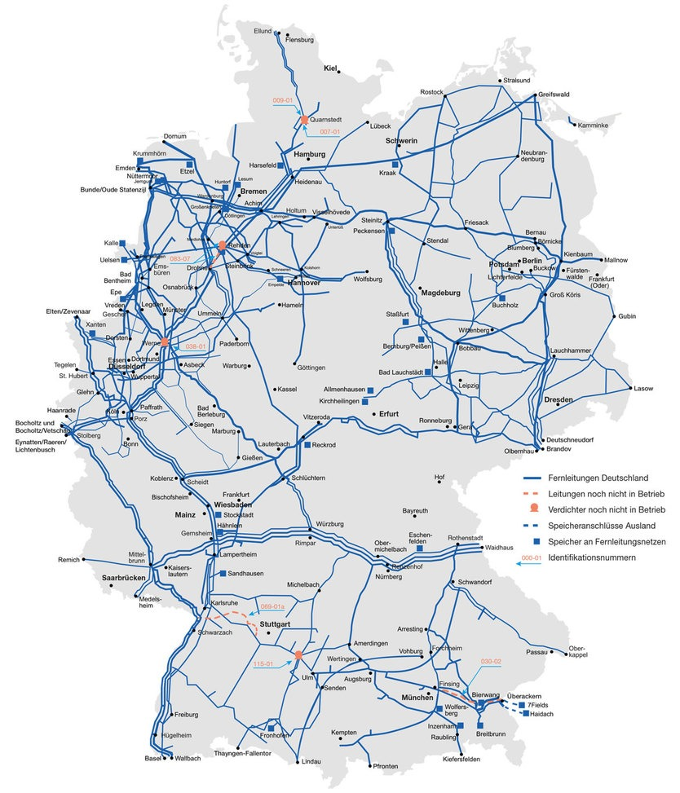
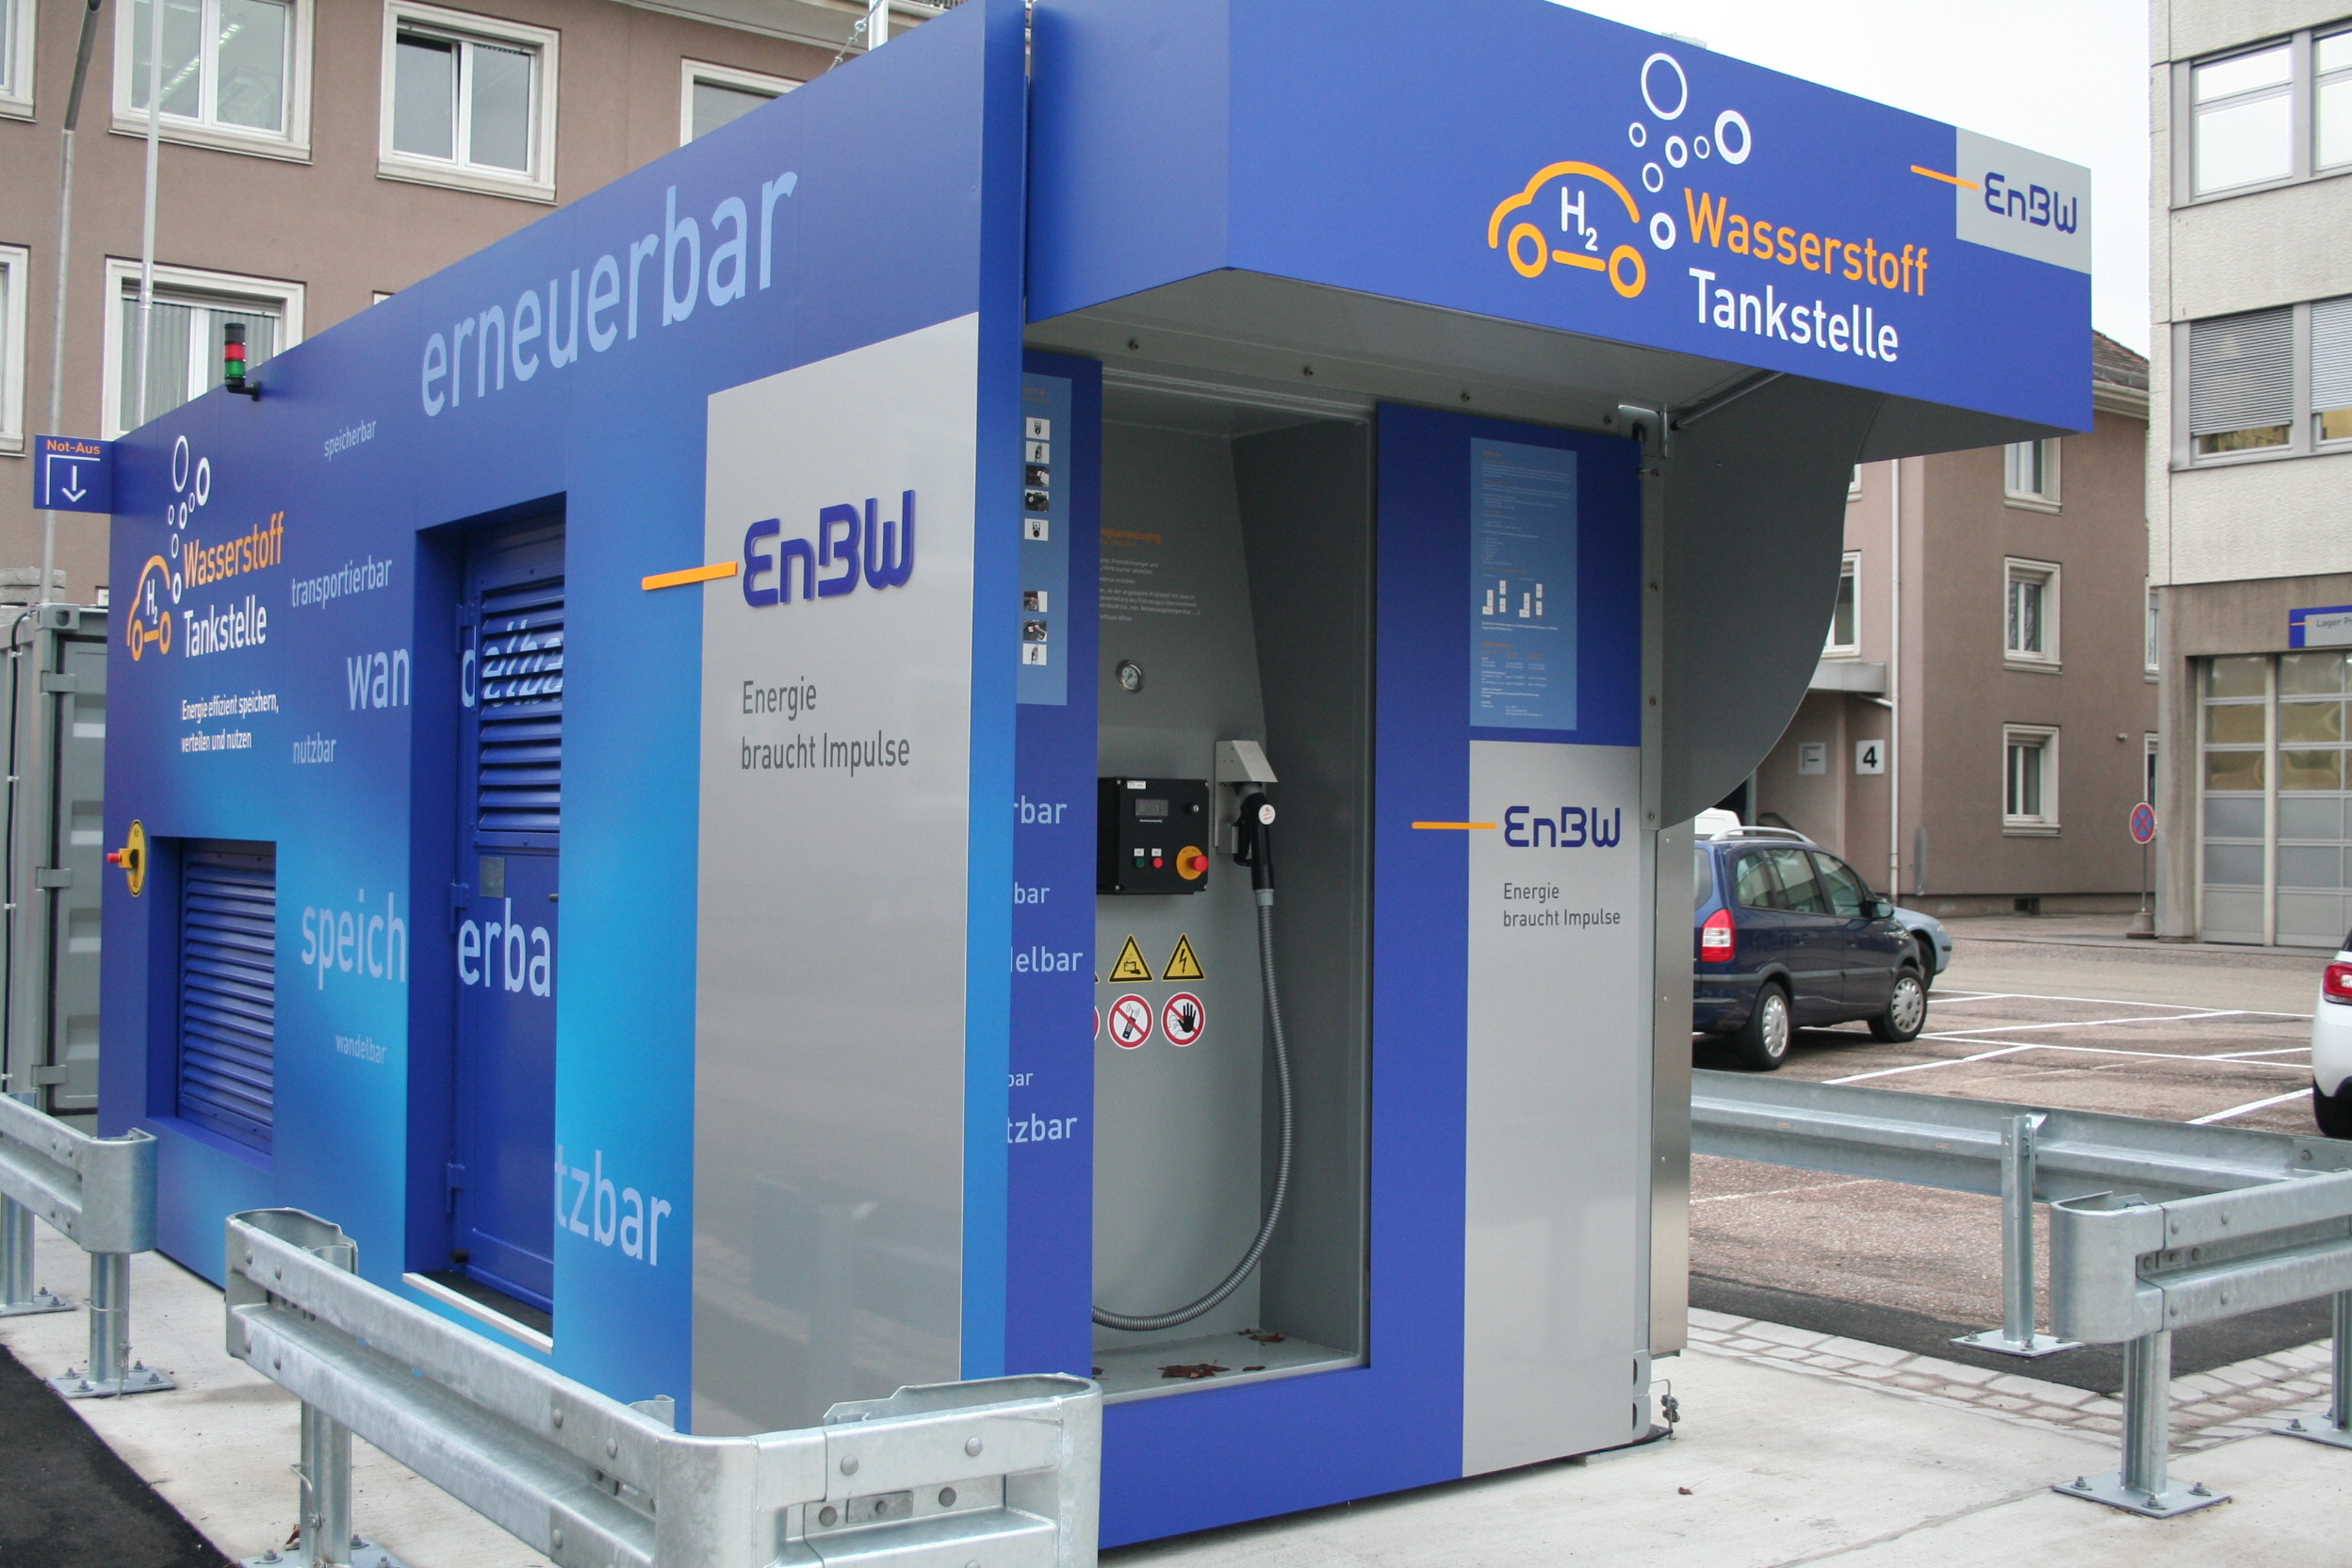
Future developments
Electrolysis at Home
Electrolysis with salt water
Natural Gas Network as Hydrogen storage
Reverse Fuel Cells
© Sunfire
© CC-BY 3.0 User:Baranekstuttgart @ de.wikipedia.org
© H. Dai, Yun Kuang, Michael Kenney
© Vereinigung der Fernleitungsnetzbetreiber Gas e.V
Notes:
https://www.nzz.ch/wissenschaft/epfl-forscher-entwickeln-wasserstofftankstelle-fuer-zuhause-ld.1515444
Swiss university: H2 compressor size of fridge, stores H2 w/o additional energy supply
Enables refuel at home, like battery.
https://www.scinexx.de/news/energie/wasserstoff-aus-meerwasser/
Standford University developed special coating to prevent corrosion, reached same efficiency as uncoated systems.
Easy upgrade path for existing plants.
https://www.chemietechnik.de/dvgw-will-das-erdgasnetz-fuer-wasserstoff-einspeisung-fit-machen/
German Gas&Water Association to increase hydrogen volume-percentage from 5 to 20.
10 vp are allowed now, shall be enforced until 2030.
More hydrogen in the network reduces need for reformers etc.
https://www.sunfire.de/de/unternehmen/news/detail/naechste-generation-der-hochtemperatur-elektrolyse-gestartet
German company „Sunfire“ developed new Reversible Solid Oxide Cell for industrial use. 80%Effi in trial. Joint Venture with Total, Air Liquide and DLR
Switch operating mode within 10 minutes, reduces idle times, increases economical efficiency.
3,75 kWh/Nm³. High-Temp-System, not suitable for mobile applications.

Slide 9
Summary
Fuel Cells both simple and complicated
Many applications and even more will follow.
Many issues still to be resolved
Promising developments in the coming years

Slide 10

Thank you!

